Slide 1




Public Board Meeting
and Annual Conference
2024
Thursday 10th October 2024
Worcester Rugby Football Club

Slide 2











Housekeeping Announcements
Fire Safety
Photography
British Sign
Language
Public
Participation
Toilets/breaks
Mobile Phones

Slide 3

Attendance
with Jo Ringshall, Chair, Healthwatch Worcestershire
Directors
Jo Ringshall – Chair
Simon Adams – Managing Director
John Taylor, Chris Byrne, Debbie Lamont
Don Beckett - Directors
Co-opted Members
St Paul’s Hostel – Erica Burlace
Young Solutions – Pete Sugg
Sandycroft – Lee McKenzie
Parent Carers Forum – Hazel Shaw
Volunteer – David Saunders

Slide 4


Declarations
of Interest

Slide 5


Item 3
Healthwatch Worcestershire
Report
Information and support available to People living with Dementia and their Carers.
Introduced by John Taylor,
Director
Healthwatch Worcestershire
To retrospectively approve the report and receive Worcestershire’s Integrated Care System’s response.

Slide 6
Information and Support for
people diagnosed with dementia
July 2024
Presentation
The full report is available on our website

Slide 7
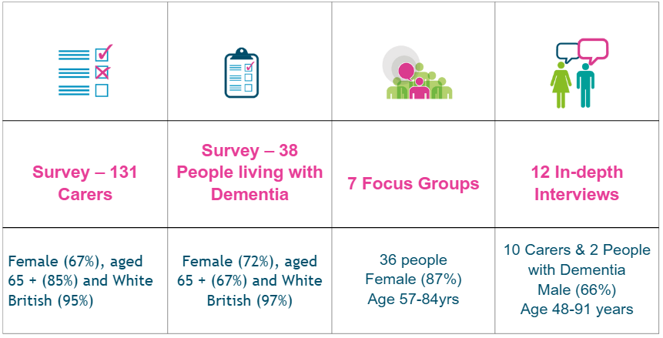
What We Did
We heard the experiences of 217 people

Slide 8
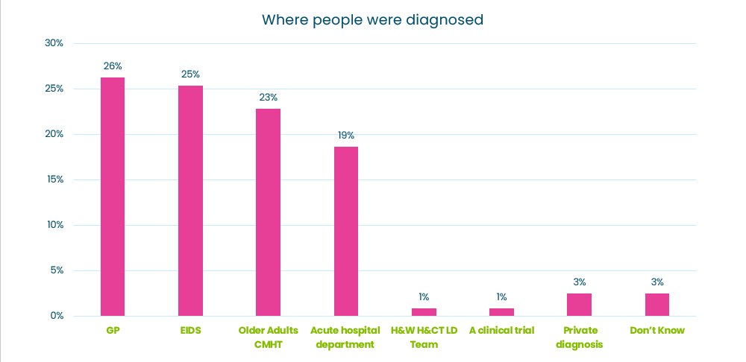
Where were people diagnosed?
People were diagnosed through a range of pathways -
where they were diagnosed impacted their post diagnosis support and experience.

Slide 9
Key Themes
  Information and support after diagnosis
  Age UK Herefordshire & Worcestershire Dementia Wellbeing Service
  Care planning
  Support from GPs and other Health Services
  Support from Social Care Services
  Support in the community for People Living with Dementia
  Young Onset Dementia
  Support For Carers

Slide 10
What Now?
53 Recommendations grouped around themes: System Action Plan: HWW further information
Role of Primary Care – in care planning, information and support, annual reviews
(Online Dementia Roadmap part of solution but not the answer)
Care Planning – required across all the diagnostic pathways, including GPs (not only HWHCT)
Recommissioning of Post Diagnostic Support Service – co-production - mechanism by which Healthwatch Worcestershire can help shape the specification.

Slide 11
Integrated Care System’s
Response
From:
Dr John Devapriam, Chief Medical Officer, Herefordshire and Worcestershire Health and Care NHS Trust and Chair of the Integrated Care Board Dementia Programme Board
Richard Keble, Programme Director for Mental Health, Learning Difficulties and Autism, NHS Herefordshire and Worcestershire

Slide 12

Item 4
Adult Attention Deficit Hyperactivity Disorder (ADHD) service
Introduced by Simon Adams
Managing Director
Healthwatch Worcestershire
Guest Speaker:
Richard Keble
Programme Director for Mental Health, Learning Difficulties and Autism
NHS Herefordshire and Worcestershire

Slide 13

Adult ADHD – Herefordshire & Worcestershire
Richard Keble, Programme Director, Mental Health, Learning Disability and Autism,

Slide 14
Attention-Deficit and Hyperactivity Disorder (ADHD)
…. is a life-long neurological condition which affects people’s behaviour. Without effective treatment and symptom management, adults can have difficulty in day to day living, including maintaining employment and relationships – these in turn can have an impact on mental health. Understanding, recognition and treatment of ADHD has grown over the last decade, and in particular since the COVID pandemic.

Slide 15
Local context
Trust gave notice for adult ADHD service effective from 31 July 2024
Based on estimated national prevalence data, circa 17,000 adults in H&W have ADHD
Waiting list is over 3000 people in Worcs
Referral rate is at least 100 per month
Right to Choose has expanded rapidly with variable offer and quality
Working group including ICB, GPs, Trust managers, pharmacists, psychiatrists in place for last 12 months, informed by regional and national insights and patient feedback via complaints / representations.

Slide 16
Adult ADHD Pathway for H&W ICS
GPs
Patient referral
Assumptions:
GP tool to identify whether patient may have ADHD
Diagnostic assessment and follow-up is NICE compliant
Investment in Primary Care to deliver review capacity and capability
Shared Care agreement with accredited providers
Under development: Screening / triage tool deployed to identify likelihood of person being severely affected by ADHD
Reviews for MH support and refers on
diagnostic assessment threshold
Accredited Right to Choose Providers
Diagnostic assessment
NOT MET
MET
Treatment planning
Enhanced Primary Care Hub
Young people in transition / adults from out of area
Treatment maintenance / prescribing
Medication Titration
Time-limited Psychoeducation
Review and follow up

Slide 17
Where are we now:
Trust has retained responsibility for all adults they were reviewing until 31 March 2025
Finalising a list of accredited Right to Choose Providers for assessment, and where appropriate, medication initiation and titration
ICB has agreed to commission medication reviews from the Worcestershire GP Federation Vertis Health – we are aiming for this to start in the New Year
ICB has started conversations with an independent provider to address the waiting list.

Slide 18

Item 5
Sensory Impairment -
ICB Governance
Introduced by Jo Ringshall
Chair
Healthwatch Worcestershire
Guest speaker: Dr Sarah Raistrick
Non-Executive Member focusing on Health Inequalities, Participation and Engagement, NHS Herefordshire and Worcestershire Integrated Care Board.

Slide 19
Item 5
Sensory Impairment -
ICB Governance
Engagement with D/deaf community
    Findings
    ICB – letter & response
Engagement with People with Vision Impairment
    Report & Recommendations
    ICB – response

Slide 20



Refreshment Break

Slide 21

Public Board Meeting Continued...
Item 6 - Minutes of Public Board Meeting 22 March 2024
and Matters Arising

Slide 22

To approve the minutes of the Public Board Meeting on 22 March 2024
Matters Arising
NHS Commissioning of Voluntary and Community Sector
Simon Adams

Slide 23
Item 6 continued
Matters Arising...
Cancer Screening: Patients access to, and experience of NHSE’s ‘Informed Choice’ Prostate Screening Service for cancer.
Chris Byrne and Don Beckett
Hospital Discharge
Chris Byrne

Slide 24

Item 7
Annual Report
2023-24

Slide 25


Speaking up for people, particularly the most vulnerable.
Making a difference.
Improving health and social care for all.
People in Worcestershire have their health and social care needs heard, understood and met.
Independent, Actively Listening, Evidence Based, Improvement, Inclusive, Confidentiality, Influencing
Transparent

Slide 26

Listening to people who use health and care services

Slide 27

Our reports and recommendations

Slide 28

Improving the quality of health and care services

Slide 29

Making sure people are involved in planning and reviewing services

Slide 30
Signposting people to advice and information

Slide 31



Video

Slide 32

Item 8
Young People’s Health & Emotional Wellbeing report
Introduced by Debbie Lamont
Director
Healthwatch Worcestershire

Slide 33
Project Aims
The aim of the project was to hear young people’s views on their own physical health and their emotional wellbeing.
It also sought to understand where they looked for information about health and wellbeing.
It gave young people an opportunity to feedback on their experiences accessing support.

Slide 34
What We Did
We heard from a total of 249 young people from all six districts of Worcestershire

Slide 35
Key Findings
Young people’s physical health is mainly good, but they experience poorer emotional wellbeing / mental health.
We wanted to understand if young people felt they had enough information and where they sought out information:
The top 3 places that young people use for information are: Google, NHS England and school/college website
Sadly, support services for emotional wellbeing were poorly rated with many still waiting to access or having been rejected with no alternative offered.

Slide 36
Key Findings
  Nearly half - of young people have stopped doing activities that are fun and relaxing in the last year due to poor mental health and/or rising costs and their family’s financial situation.
  Young people were aware of Worcestershire based online information on health and wellbeing, BUT their willingness to use it is low.
  Young people are telling us very clearly that the type of support that they would find helpful are one-to-one in-person sessions. They are reluctant to use video calling or group sessions and are likely to reject or refuse to engage with these options.
  72% said 1:1 sessions outside of school/college were their preferred option.

Slide 37
Gender Identity
11 young people told us they identified as gender diverse.
4 (36%) of those young people felt they needed support around their gender identity but, despite asking, had not received any.
Those that had received support found it very mixed.

Slide 38
Neurodiversity
53 (34%) of the young people taking part, said they identified or thought they might identify as neurodiverse
Just under half of those young people did not have an Education and Health Care Plan (EHCP) in place to set out their support and health care needs.
Of those that did have an EHCP, over half said it did not provide the support they needed.
Neurodiverse young people told us that both their physical and emotional wellbeing/Mental health are proportionally worse than their neurotypical peers. Their access to information about health and wellbeing was poorer too.

Slide 39
What Now?
We have made 26 recommendations for Worcestershire’s health and social care services based on our findings, covering the following areas:
  Access to information on Health and Emotional Wellbeing
  Access to affordable healthy activities
  Access to in-person emotional support
  Transition to adult services
  Gender identity
  Neurodiversity
  Education, Health and Care Plans (EHCP)
  Young people with learning disabilities
We have requested an integrated care system response to these recommendations.

Slide 40

Item 9
Update from Healthwatch Worcestershire’s Quality Summit
Introduced by Chris Byrne
Director
Healthwatch Worcestershire

Slide 41
Healthwatch Worcestershire Quality Summit Meeting
8th May 2024
Spotlight Report:
We asked attendees to discuss at their tables and to flipchart the key points of their discussions on:
How Can Health and Care Services Improve their Communication with Service Users?

Slide 42


Slide 43
Top-line recommendations:
Talk to patients:
  Thoughtful use of phone/text/email/social media/letters
  Remember some patients don’t use tech.
Tell your story once:
  ‘I’ve already said all this to my GP/Nurse/Consultant/Physio etc….’
  Can we have one joined up record system?
Awareness of people as Individuals:
  Help the patient/carer voice their concerns
  Some individuals need different discussions/respect differences

Slide 44
Top-line recommendations:
Written & Verbal Language:
  Keep it simple doesn’t mean dumb it down
  Pay attention to non-English speakers/sight & hearing concerns/Carers/families
Discharge:
  Better communications at admission; start discharge as soon as possible and don’t leave it too late when in discharge lounge.

Slide 45
Responses to unanswered questions raised at the Quality Summit in May 2024

Slide 46

Item 10
Update on plans for Stroke services in Worcestershire
Introduced by Chris Byrne
Director
Healthwatch Worcestershire

Slide 47

Item 11
Healthwatch Worcestershire’s
comments on
Quality Accounts 2023/24
Chris Byrne
Director
and Simon Adams
Managing Director
Healthwatch Worcestershire

Slide 48
Item 11
Healthwatch Worcestershire’s
comments on
Quality Accounts 2023/24
Our comments on the following Quality Accounts for retrospective approval:
•West Midlands Ambulance Service
•Worcestershire Acute Hospitals NHS Trust
•Herefordshire and Worcestershire Health and Care NHS Trust

Slide 49

Item 12
Worcestershire County Council’s response to our Public Health Messaging report
To note and consider Worcestershire County Councils response to Healthwatch Worcestershire’s Public Health Messaging report
Simon Adams

Slide 50

Item 13
Public Participation

Slide 51

Item 14
Announcements by the Chair

Slide 52

Thank you for your time
Join us again on
28th November 2024 online for our next
Public Board Meeting

Slide 53

Lunch and Networking

